Slide 1
Activity
An activity is a single, focused thing that the user can do.
It represents a single screen with a user interface
An application can have zero or more activities.

Slide 2
Configuring the manifest
For your app to be able to use activities, you must declare the activities, and certain of their attributes, in the manifest.
<manifest ... > <application ... > <activity android:name=".ExampleActivity" /> ... </application ... > ... </manifest >
The only required attribute for this element is android:name, which specifies the class name of the activity. You can also add attributes that define activity characteristics such as label, icon, or UI theme.

Slide 3
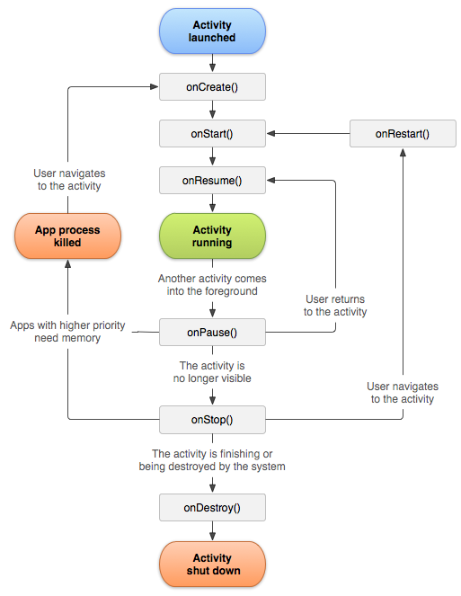

Slide 4
Activity Essential States
An activity has essentially four states:
If an activity in the foreground of the screen (at the top of the stack), it is active or running.
If an activity has lost focus but is still visible (that is, a new non-full-sized or transparent activity has focus on top of your activity), it is paused. A paused activity is completely alive (it maintains all state and member information and remains attached to the window manager), but can be killed by the system in extreme low memory situations.

Slide 5
Activity Essential States
If an activity is completely covered by another activity, it is stopped. It still retains all state and member information, however, it is no longer visible to the user so its window is hidden and it will often be killed by the system when memory is needed elsewhere.
If an activity is paused or stopped, the system can drop the activity from memory by either asking it to finish, or simply killing its process. When it is displayed again to the user, it must be completely restarted and restored to its previous state.

Slide 6
Important Activity Events
onCreate()
Called when the activity is first created. This is where you should do all of your normal static setup: create views, bind data to lists, etc.
This method also provides you with a Bundle containing the activity's previously frozen state, if there was one.

Slide 7
Important Activity Events
onRestart()
Called after your activity has been stopped, prior to it being started again.
onStart()
Called when the activity is becoming visible to the user.

Slide 8
Important Activity Events
onResume()
Called when the activity start interacting with the user. At this point your activity is at the top of the activity stack, with user input going to it.
onPause()
Called when the system is about to start resuming other activity.
This is typically used to commit unsaved changes to persistent data, stop animations and other things that may be consuming CPU, etc.
Implementations of this method must be very quick because the next activity will not be resumed until this method returns.

Slide 9
Important Activity Events
onStop()
Called when the activity is no longer visible to the user, because another activity has been resumed and is covering this one.
This may happen either because a new activity is being started, an existing one is being brought in front of this one, or this one is being destroyed.

Slide 10
Important Activity Events
onDestroy()
The final call you receive before your activity is destroyed.
This can happen either because the activity is finishing (someone called finish() on it, or because the system is temporarily destroying this instance of the activity to save space.

Slide 11
Three Key Loops
1. Entire Lifetime
From onCreate() to onDestroy()
For example, if it has a thread running in the background to download data from the network, it may create thread in onCreate() and then destroy the thread in onDestroy().

Slide 12
Three Key Loops
2. Visible Lifetime
From OnStart() to OnStop()
During this time the user can see the activity on-screen, though it may not be in the foreground and interacting with the user.

Slide 13
Three Key Loops
3. Foreground Lifetime
From onResume() to onPause()
During this time the activity is in front of all other activities and interacting(specially input) with the user.
An activity can frequently go between the resumed and paused states, so the code in these methods should be fairly lightweight

